Slide 1

Design & Verification of an ALU using UVM & SVA
Abdelrahman Mohamed Yassien dir: /home/svgpdv25abohamad/alu_uvm_project

Slide 2
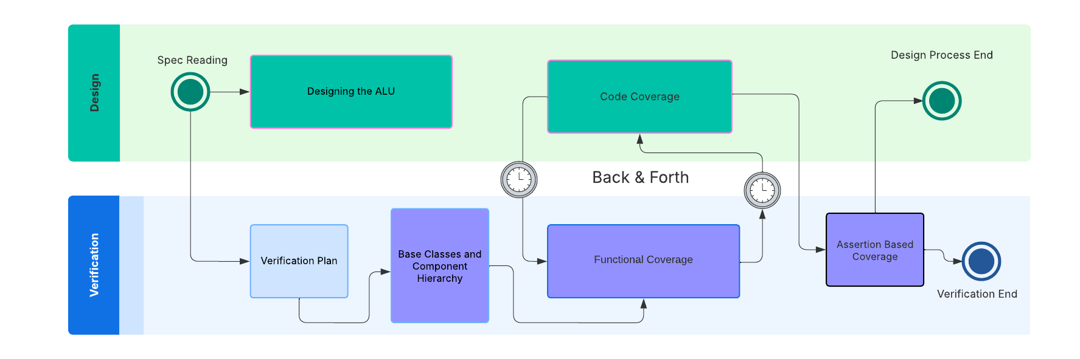
Project Timeline

Slide 3
Verification Plan
Plan | Description
Reset DUT | Resetting the DUT
ALU_en | Sending transactions while ALU_en is off
A_op Opcodes | Checking all A_op opcodes when (A_en & ~B_en)
B_11op Opcodes | Checking all B_op opcodes when (A_en & B_en)
Random Reset | Randomly Resetting the DUT during the entire simulation
Code Coverage | Ensuring all the DUT’s code lines were HIT using code coverage and making better test cases if not.
Functional Coverage | Ensuring all opcodes/values are met and tried using Functional Coverage and Fixing the DUT if not
Error Injection | Using an Error Injection scenario to check if the DUT hangs or behaves in a destructive way if faced with an undefined state or an out-of-bounds/unexpected inputs
Assertion Based Coverage | Asserting over the design specs, clock period, alu operations, alu_en, rst_n

Slide 4
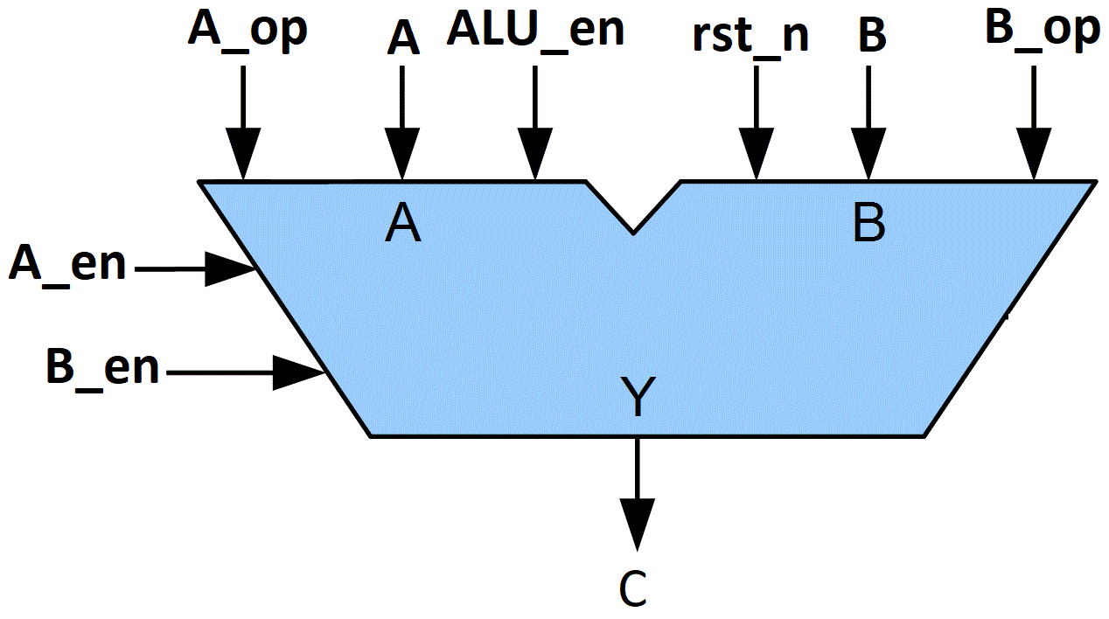
ALU DESIGN SPECIFICATIONS
(A_EN & ~B_EN) | A_op | C = ? | Description
 | 0 | A + B | Sum of inputs
 | 1 | A – B | B subtracted from A
 | 2 | A ^ B | A bitwise XOR B
 | 3 | A & B | A bitwise & B
 | 4 | A & B | A bitwise & B
 | 5 | A | B | A bitwise OR B
 | 6 | ~(A ^ B) | A XNOR B
 | 7 | NULL | Not permitted to take this value
(A_EN & B_EN) | B_op | C= ? | Description
 | 0 | A + B | Sum of inputs
 | 1 | A – B | B subtracted from A
 | 2 | A ^ B | A bitwise XOR B
 | 3 | A & B | A bitwise & B
(~A_EN & B_EN) | B_op | C = ? | Description
 | 0 | ~(A & B) | A NAND B
 | 1 | A + B | Sum of inputs
 | 2 | A + B | Sum of inputs
 | 3 | NULL | Not permitted to take this value

Slide 5
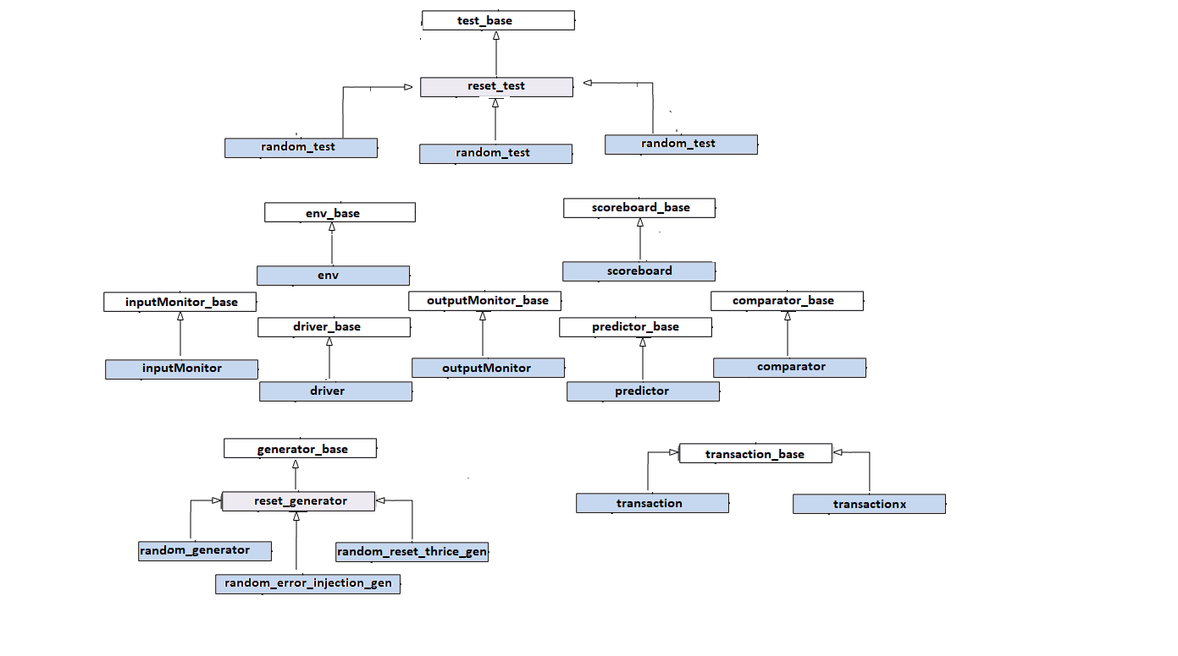
Verification Environment Classes

Slide 6
TOP ALU TESTBENCH
RANDOM TEST
ERROR_TEST
REPITITION TEST
ENVIRONMENT
SCOREBOARD
ALU AGENT
RST AGENT
Predictor
Comparator
Sequence
Sequence
Coverage Collector
Virtual Sequence
Sequencer
Sequencer
DRIVER
INPUT MONITOR
OUTPUT MONITOR
MONITOR
DRIVER
Virtual Sequencer
Virtual Interface
Virtual Interface
ALU Interface
RST Interface
DUT

Slide 7
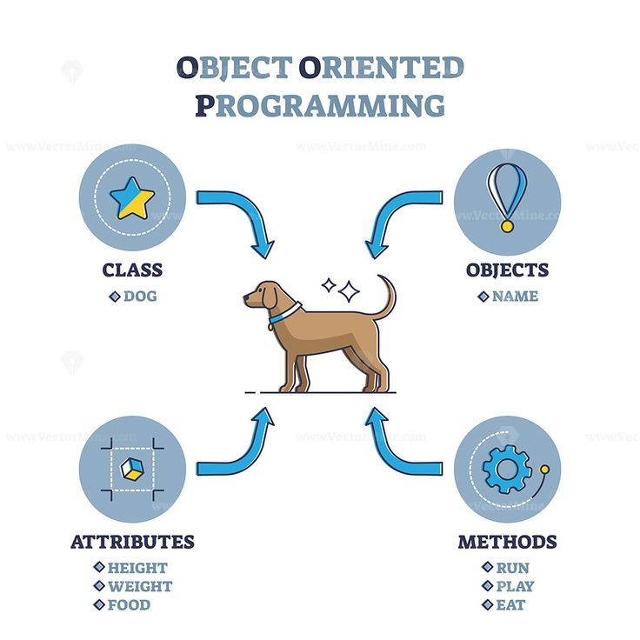
Classes? What do they do?

Slide 8
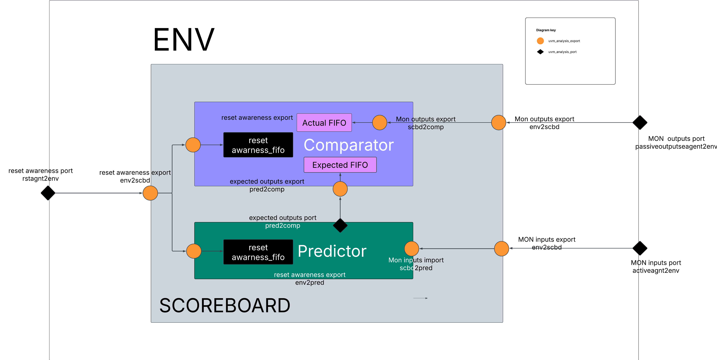
SCOREBOARD TLM DIAGRAM The hierarchy of this scoreboard is inspired from Clifford Cumming’s OVM-UVM Scoreboards-Fundamental Architectures The reset awareness was inspired from The published paper Handling Asynchronous Reset(s) Testing by building reset-awareness into UVM testbench components by Wei Wei Cheong, Katherine Garden, Ana Sanz Carretero which was previewed @DVCON 2021

Slide 9
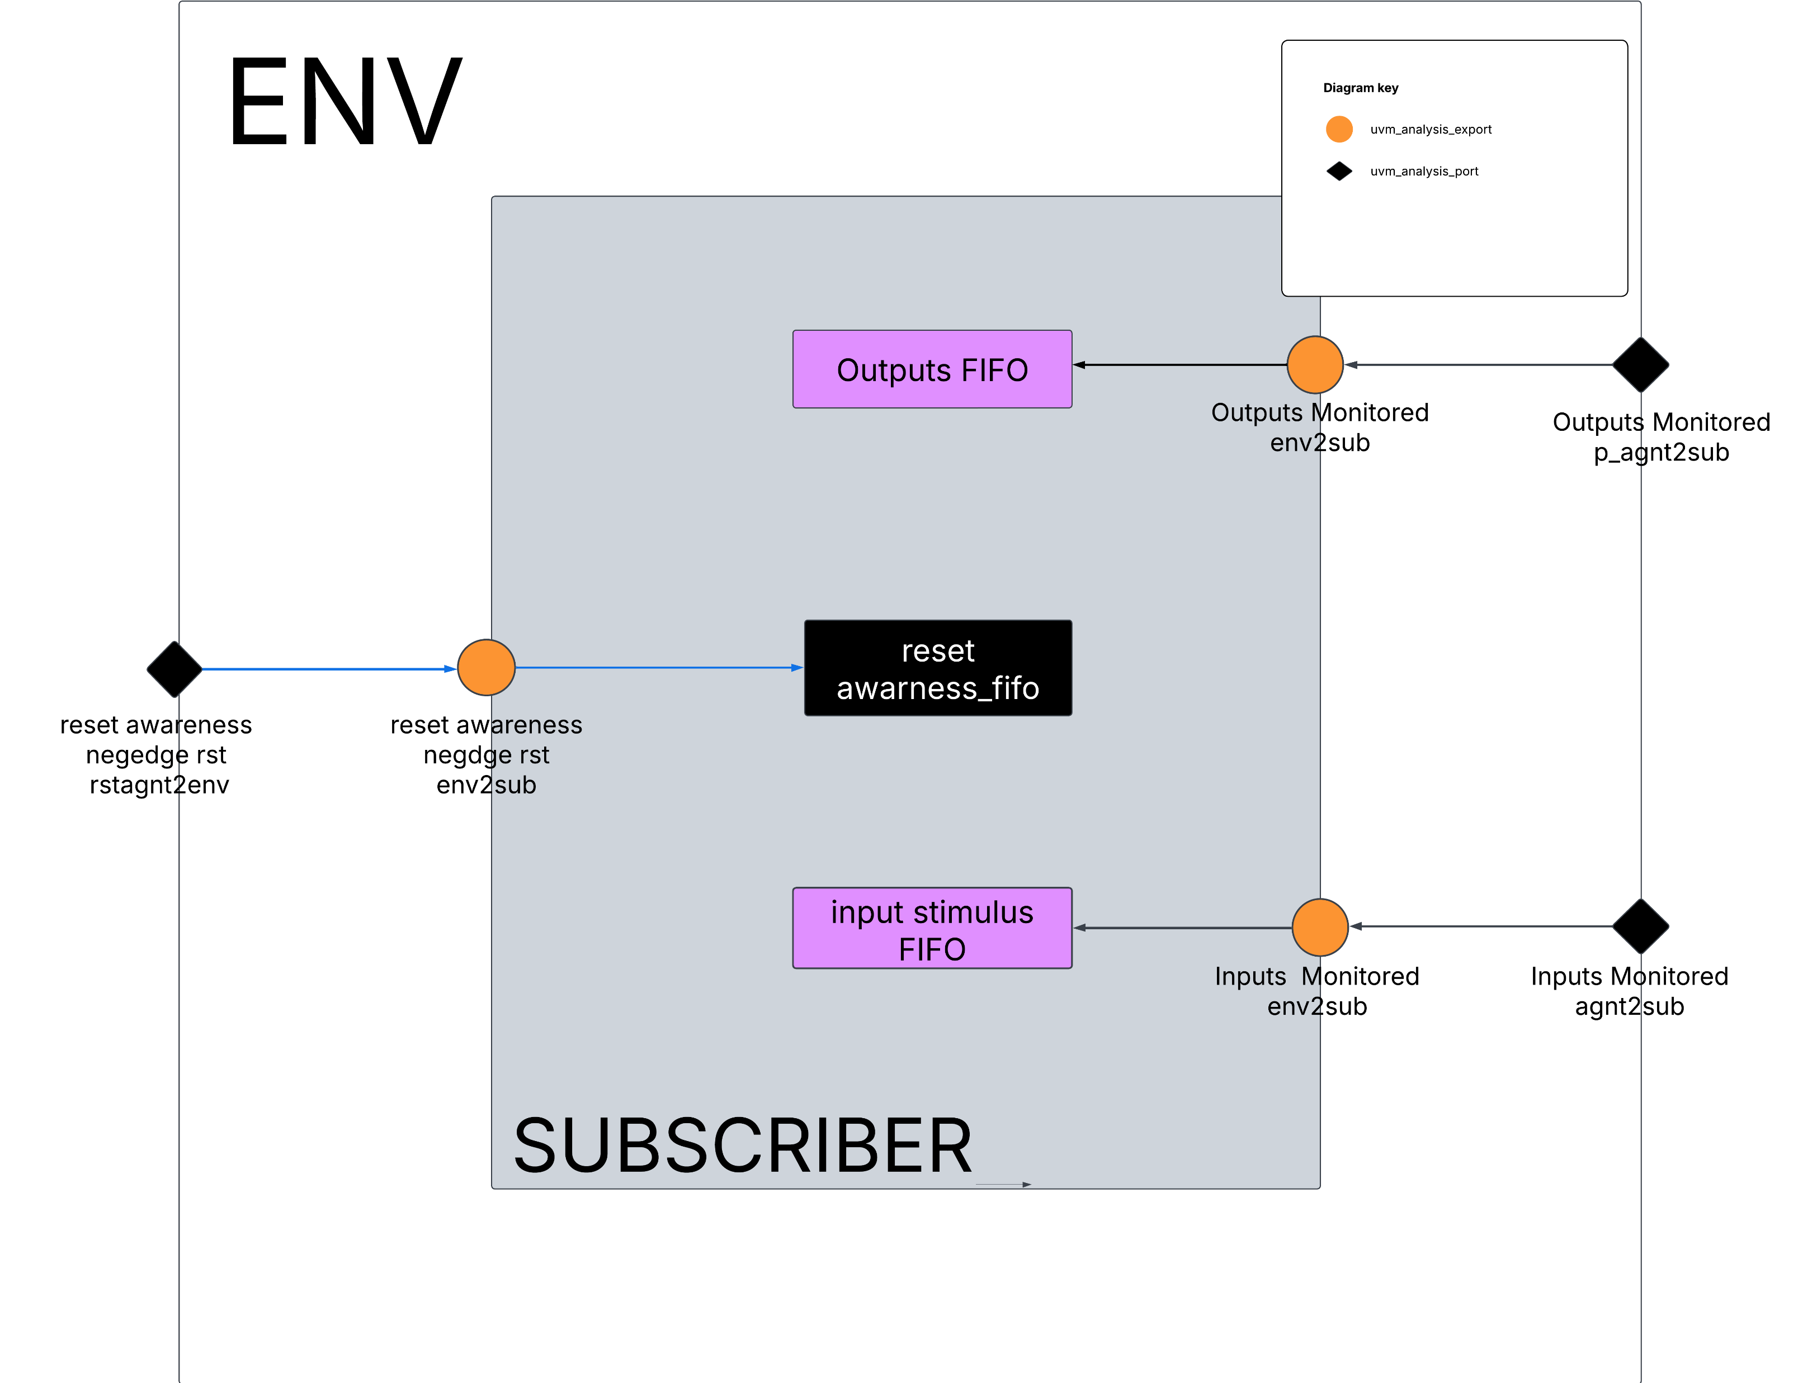
SUBSCRIBER TLM DIAGRAM The reset awareness was inspired from The published paper The reset awareness was inspired from The published paper Handling Asynchronous Reset(s) Testing by building reset-awareness into UVM testbench components by Wei Wei Cheong, Katherine Garden, Ana Sanz Carretero which was previewed @DVCON 2021

Slide 10
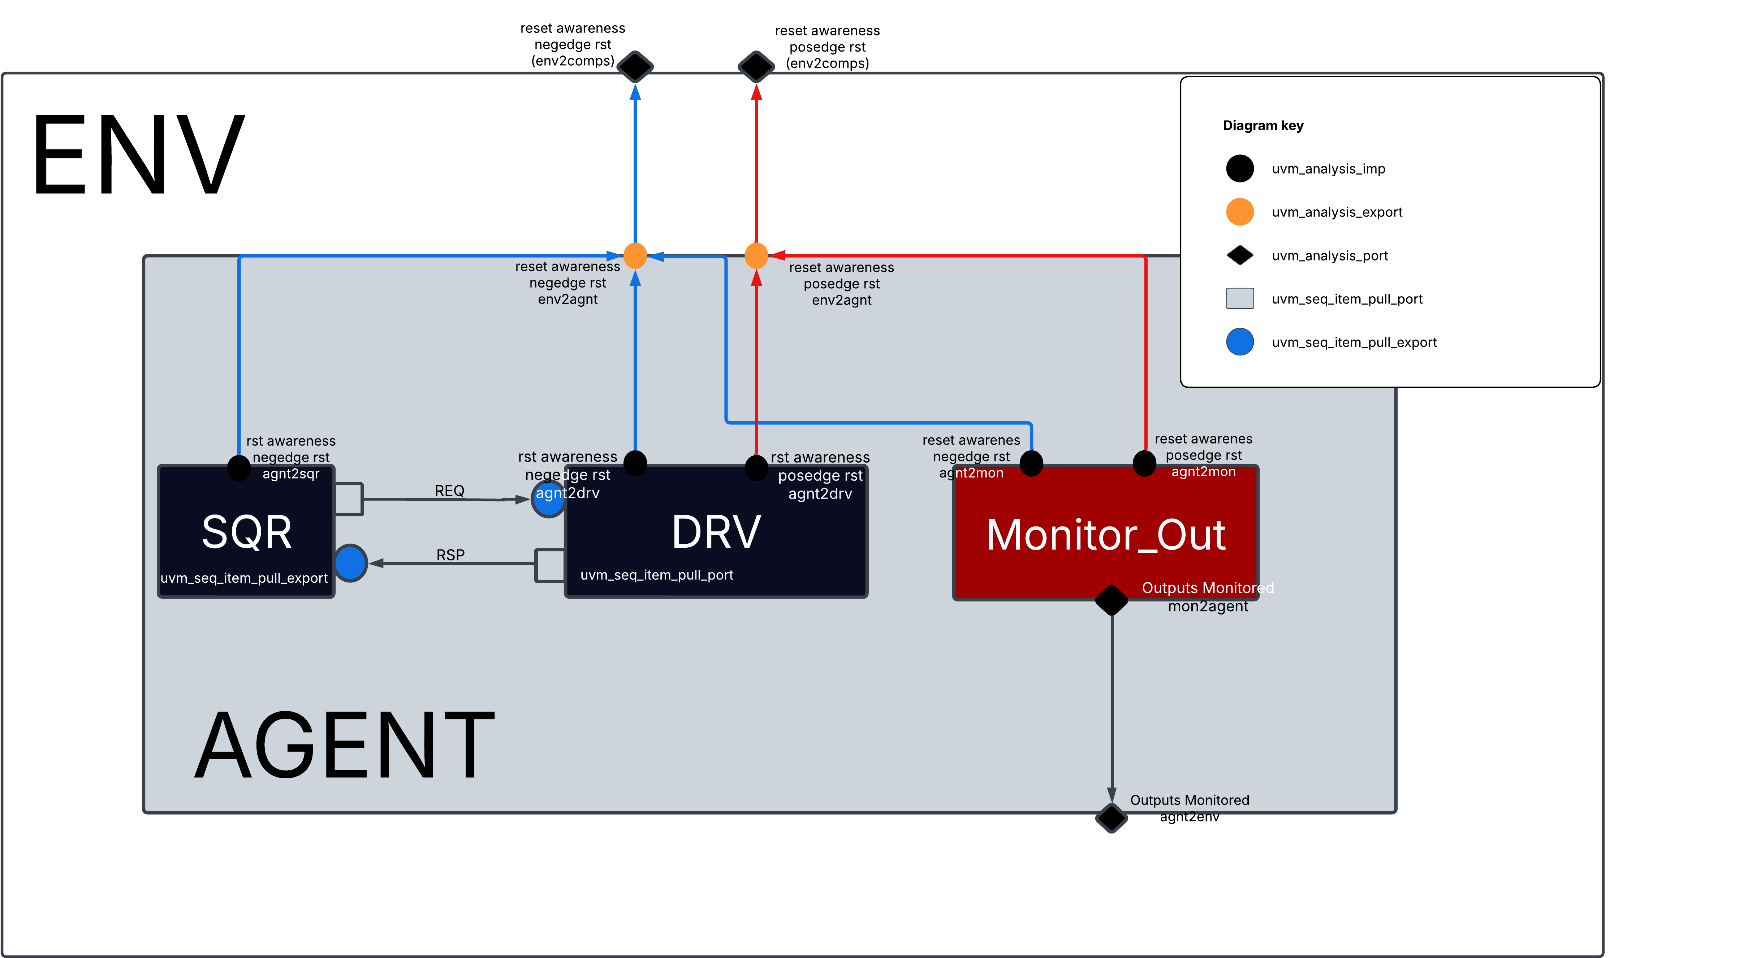
ALU AGENT TLM DIAGRAM
The reset awareness was inspired from The published paper Handling Asynchronous Reset(s) Testing by building reset-awareness into UVM testbench components by Wei Wei Cheong, Katherine Garden, Ana Sanz Carretero which was previewed @DVCON 2021
As shown in the figure, the alu agent is fully reset aware, every component is connected with uvm_tlm_analysis_imp s to allow it to react to asynchronous reset assertion.
Note: the sequencer in this agent the stop_sequences() function is called within the write function body defined @it, therefore stopping all sequences and calling item_done to all the current running items by the driver.

Slide 11
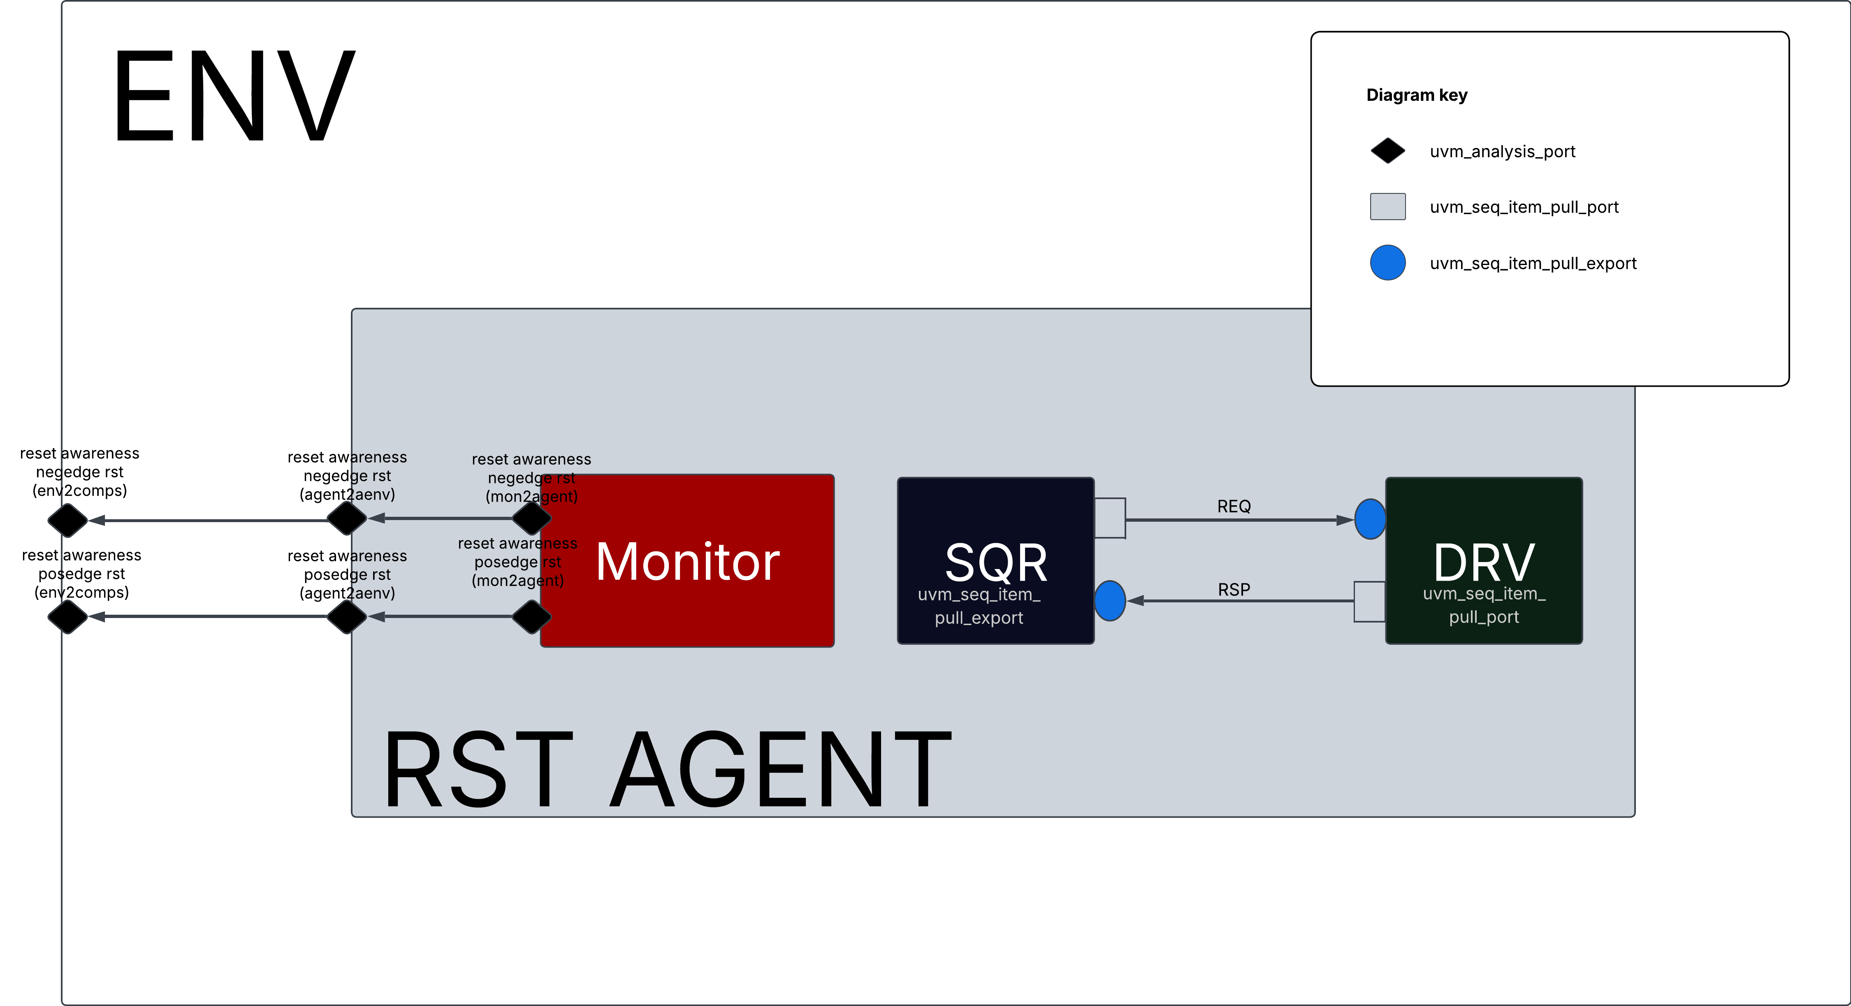
RST AGENT TLM DIAGRAM
The reset awareness was inspired from The published paper Handling Asynchronous Reset(s) Testing by building reset-awareness into UVM testbench components by Wei Wei Cheong, Katherine Garden, Ana Sanz Carretero which was previewed @DVCON 2021
As shown in the figure, the rst agent monitor class is always waiting for reset assertion, and as soon as it is asserted, the monitor class writes to the uvm_tlm_analysis_port so it reaches every reset_aware component and hence allows them to act accordingly.

Slide 12
ENVIRONMENT
ENV
Constructs the parent using super.new();
Instantiates all the environment components (Agents, Virtual Sequencer..etc) and Creates them using uvm_factory
Connects the rst_agent tlm to the rest of the environment (Scoreboard, Subscriber, alu_agent). Also uses get_provided_to and get_connected_to to debug TLM connections.
Initializes both rst_agent & alu_agent configs and sets them to their prespective agents

Slide 13
ALU ACTIVE AGENT
ALU AGENT
Constructs the parent using super.new();
Receives Configuration from alu_agnt config file
Inestantiates Input_Monitor, Driver & Sequencer
Is fully reset aware

Slide 14
ALU DRIVER
DRIVER
Constructs the parent using super.new();
Translates the transaction level items to pin level ones.
Receives the transactions from the sequences through seq_item_pull_port by the sequencer
Sends the stimulus to the dut & terminates operation if a rst is detected by the rst_agnt

Slide 15
ALU INPUT MONITOR
INPUT MONITOR
Constructs the parent using super.new();
Translates the pin level items to transaction level ones.
Constantly monitors the dut to observe its behavior to driven stimulus
Terminates the monitoring operation if a rst is detected by the rst_agnt

Slide 16
ALU OUTPUT MONITOR
OUTPUT MONITOR
Constructs the parent using super.new();
Translates the pin level items to transaction level ones.
Constantly monitors the dut to observe its behavior to driven stimulus
Terminates the monitoring operation if a rst is detected by the rst_agnt

Slide 17
ALU SEQUENCER
SEQUENCER
Constructs the parent using super.new();
Transmits sequence_items from alu sequences to alu_driver
Is connected to the alu_driver in the alu_agent using seq_item_pull_export
Calls Stop_sequences(); if a rst assertion is written by the rst_agent

Slide 18
RST ACTIVE AGENT
RST AGENT
Constructs the parent using super.new();
Receives Configuration from rst_agnt config file which is initialized by the environment
Inestantiates RST Monitor, Driver & Sequencer
Drives & Monitors the reset ☺

Slide 19
RST DRIVER
DRIVER
Constructs the parent using super.new();
Translates the transaction level items to pin level ones.
Receives the transactions from the sequences through seq_item_pull_port by the RST sequencer
Sends the RST ASSERTION to the dut

Slide 20
RST AGENT
RST AGENT
Constructs the parent using super.new();
Transmits sequence_items from alu sequences to alu_driver
Is connected to the alu_driver in the alu_agent using seq_item_pull_export
Calls Stop_sequences(); if a rst assertion is written by the rst_agent

Slide 21
inputMonitor & inputMonitor Base
inputMonitor_Base
Defines the mailboxes & Virtual Interface necessary for communication.
Pre-defines pure virtual execute task
inputMonitor
Constructs the parent using super.new();
Sends the sampled inputs
Translates the sampled inputs from pin level to transaction level
Sends the sampled transaction level item to the Scoreboard/Predictor

Slide 22
Coverage & Coverage Base
Coverage_Base
Defines the mailboxes & Virtual Interface necessary for communication by the entire test structure
Pre-defines pure virtual execute task
Coverage
Constructs the parent using super.new();
Receives the input stimulus and sampled outputs from the input/outputMonitor and samples them through the coverage groups accordingly.

Slide 23
Scoreboard & Scoreboard Base
Scoreboard_Base
Defines the mailboxes & Virtual Interface necessary for communication between the predictor & comparator.
Pre-defines pure virtual execute task
Scoreboard
Constructs the parent using super.new();
Receives the input stimulus & the outputs of the DUT from both the InputMonitor & the OutputMonitor.
Is the bridge of communication between the predictor & comparator

Slide 24
Predictor & Predictor Base
Predictor_Base
Defines the mailboxes & Virtual Interface necessary for communication.
Pre-defines pure virtual execute task
Predictor
Constructs the parent using super.new();
Receives sampled input items from the scoreboard/inputMonitor and calculates the supposed expected output and sends it to the comparator through the scoreboard.

Slide 25
Comparator & Comparator Base
Comparator_Base
Defines the mailboxes & Virtual Interface necessary for communication.
Pre-defines pure virtual execute task
Comparator
Constructs the parent using super.new();
Receives sampled output items from the scoreboard/outpuMonitor and compares it to the previously sampled input items

Slide 26
Transaction & Transaction Base
Transaction_Base
Rand properties of the ALU, the inputs defined as rand.
Void Do_copy(); functions that copies all the fields and assigns it to another item
String functions for better debugging i.e. input2string, output2string, item2string
Transactionx
Constructs the parent using super.new();
Defining different constraints & transaction item number
Transaction
Constructs the parent using super.new();
Defining the needed constraints & transaction item number

Slide 27
Generator & Generator Base
Generator_Base
Defines the mailboxes & Virtual Interface necessary for communication.
Pre-defines pure virtual execute task
Reset_Generator
Generates a Reset Transaction
Constructs the parent using super.new();
Random_Reset_Thrice_Generator
Constructs the parent using super.new();
Randomly generates randomized items & 3 reset transactions every now and then
Random_Generator
Constructs the parent using super.new();
Generates randomized items
Random_Error_Injection_Generator
Constructs the parent using super.new();
Removes all the design spec constraints & drives randomized items

Slide 28
Comparator & Comparator Base
Comparator_Base
Defines the mailboxes & Virtual Interface necessary for communication.
Pre-defines pure virtual execute task
Comparator
Constructs the parent using super.new();
Receives sampled output items from the scoreboard/outpuMonitor and compares it to the previously sampled input items

Slide 29
Environment & Environment Base
Enviornment_Base
Defines the mailboxes & Virtual Interface necessary for communication by the entire test structure
Pre-defines pure virtual execute task
Environment
Constructs the parent using super.new();
Inestsantiates the entire testbench structure that is under the test.

Slide 30
Test & Test Base
Test_Base
Defines the mailboxes & Virtual Interface necessary for communication.
Pre-defines pure virtual execute task
Reset_Test
Constructs the parent using super.new();
Inestantiates the reset_generator and runs the item generated by it
Random_Reset_Thrice_test
Constructs the parent using super.new();
Inestantiates the random_reset_thrice_generator and runs the item generated by it
Random_test
Constructs the parent using super.new();
Inestantiates the random_generator and runs the item generated by it
Random_Error_Injection_test
Constructs the parent using super.new();
Inestantiates the random_error_injection_generator and runs the item generated by it

Slide 31
COVERAGE? What? For What?

Slide 32
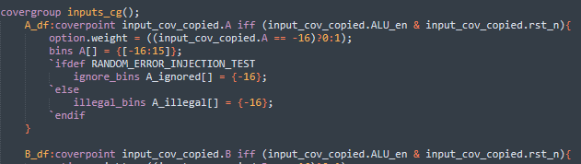
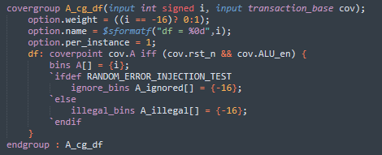

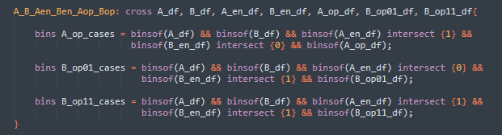
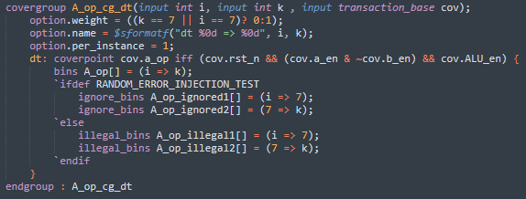


Coverage Examples
Fixed/Cross – based coverage
method
Instance – based coverage method
BODY
Construction
Sampling

Slide 33

Coverage Closure

Slide 34
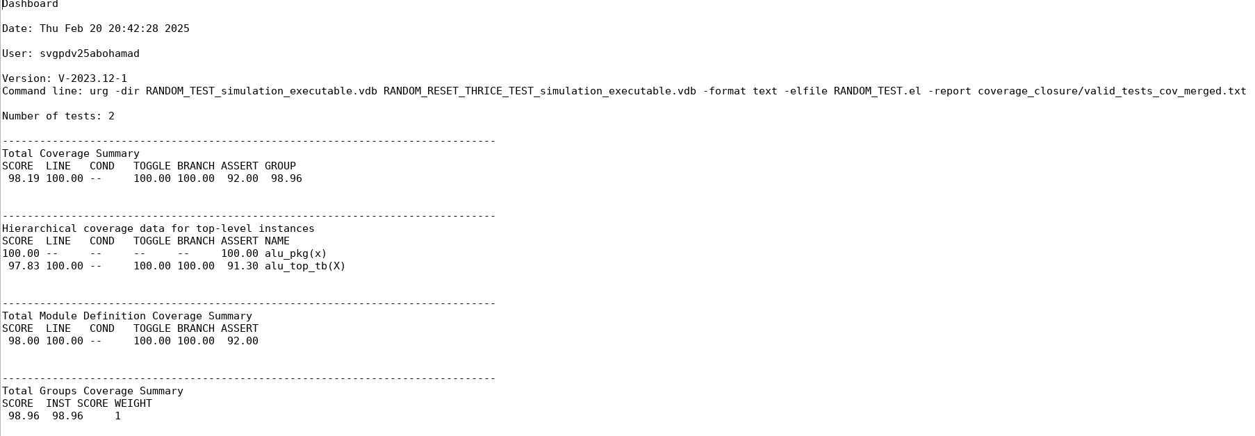
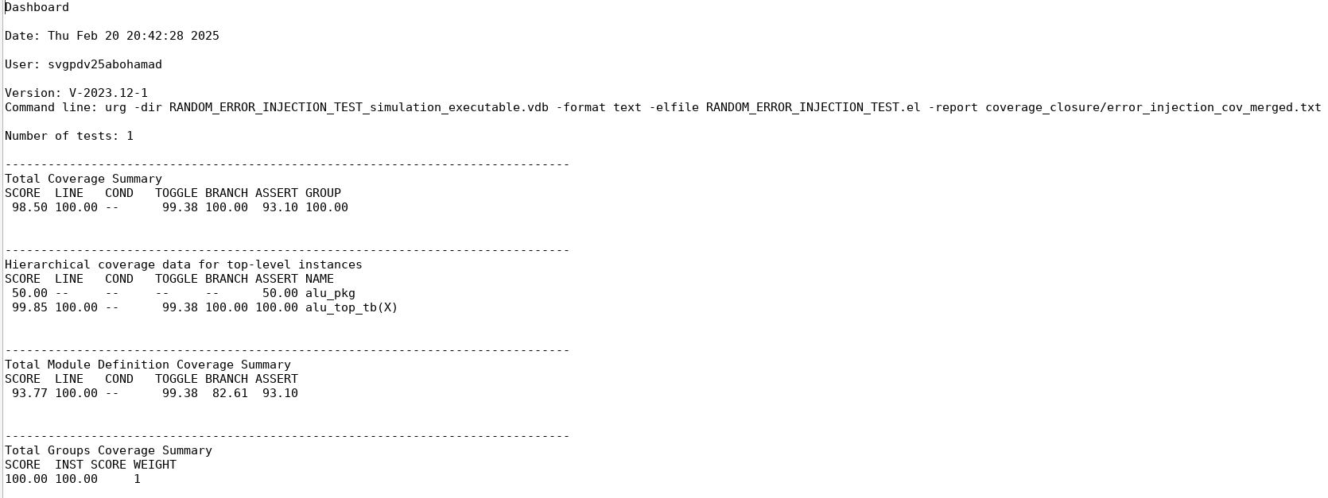
Dashboard.txt for valid Test
Dashboard.txt for Error Injection Test

Slide 35
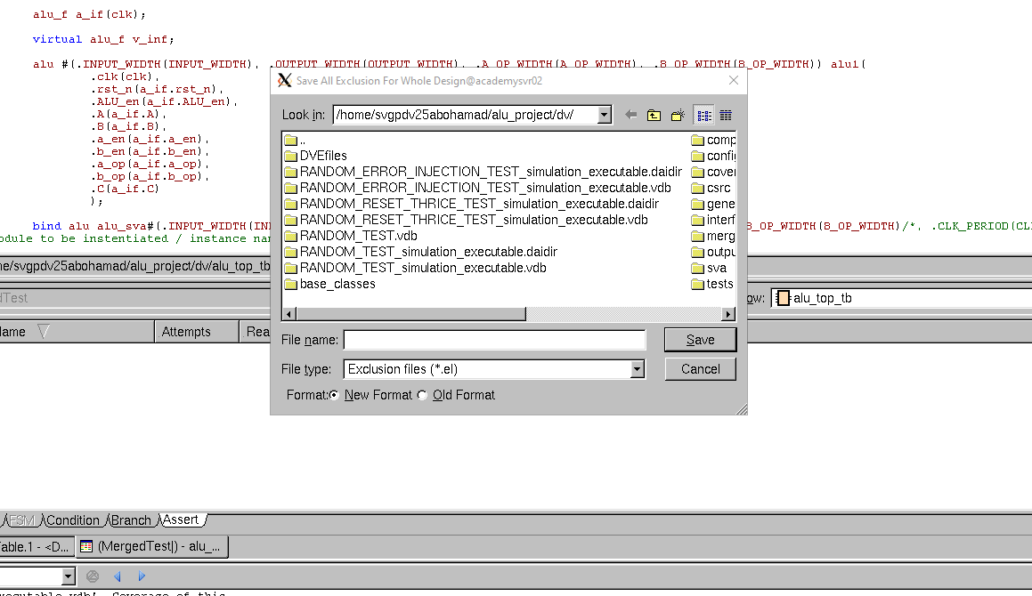
Exclusions and .el files
Exclusions can be done in the merge command line using –exclude but the naming of the branches, points, ..etc is often hard to make out and understand to just do it from the line, therefore using dve to make the .el file is much easier and thereafter including them in the report command.

Slide 36
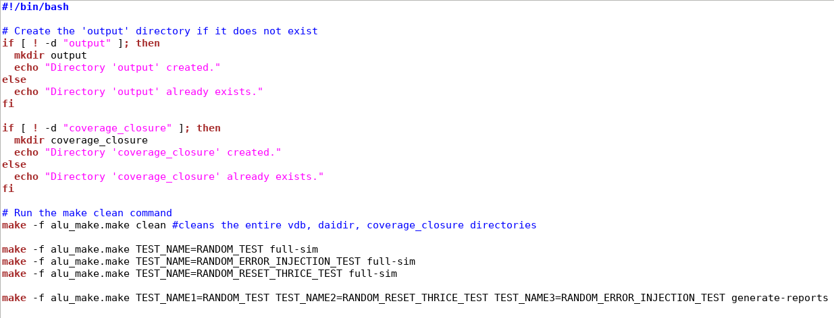
Scripting & Makefiles
A simple bash script to create ./output and ./coverage_closure directories, as well as running the make file

Slide 37
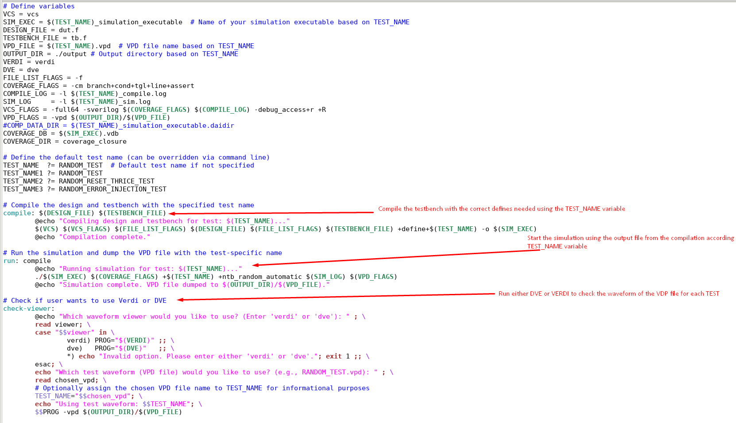
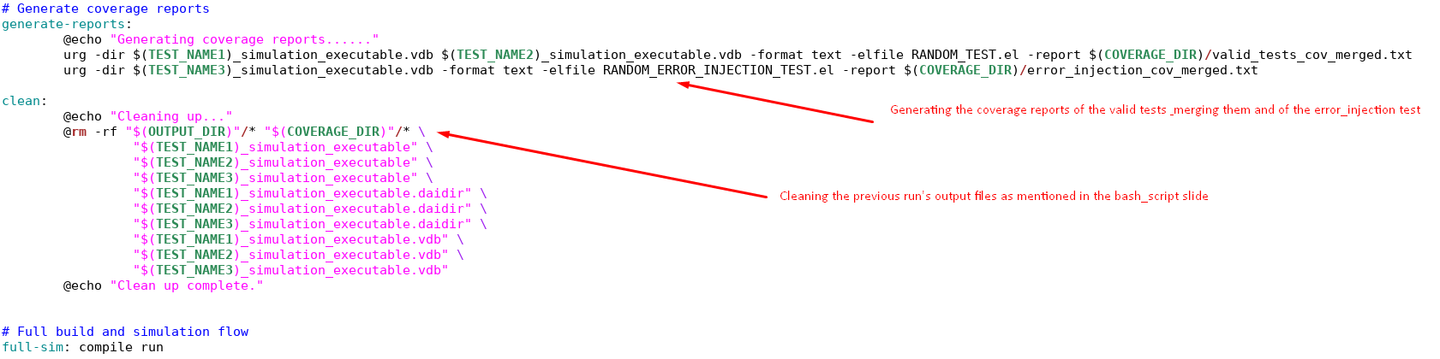
Scripting & Makefiles
Makefile to compile, run, check the simulation waveform using the .vdp files & clean each time the clean task is called or when the run_all.sh is executed
Saving compile and simulation.log files so they can be searched for any errors using a script if I have the time to make one

